Slide 1
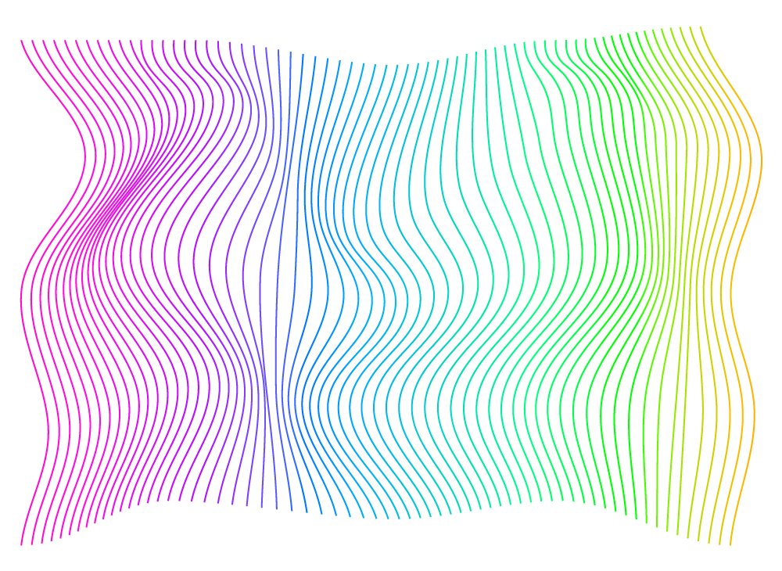

Salary Prediction
AI/ML
Galih Praditya Kurniawan

Slide 2
What is AI/ML?
Artificial Intelligence (AI)
is the creation of systems designed to simulate human intelligence and behavior. These systems are capable of performing tasks that typically require human cognitive abilities, such as decision-making, language understanding, and problem-solving.
Machine Learning (ML)
is a subfield of AI that focuses on developing algorithms that can learn patterns from data and make predictions or decisions without being explicitly programmed. ML systems improve their performance over time as they are exposed to more data.
Type of ML:
- Supervised Learning: Learning from labeled data
- Unsupervised Learning: Identifying patterns in unlabeled data
- Reinforcement Learning: Learning optimal actions through trial and error

Slide 3
SALARY
PREDICTION
Supervised Learning

Slide 4
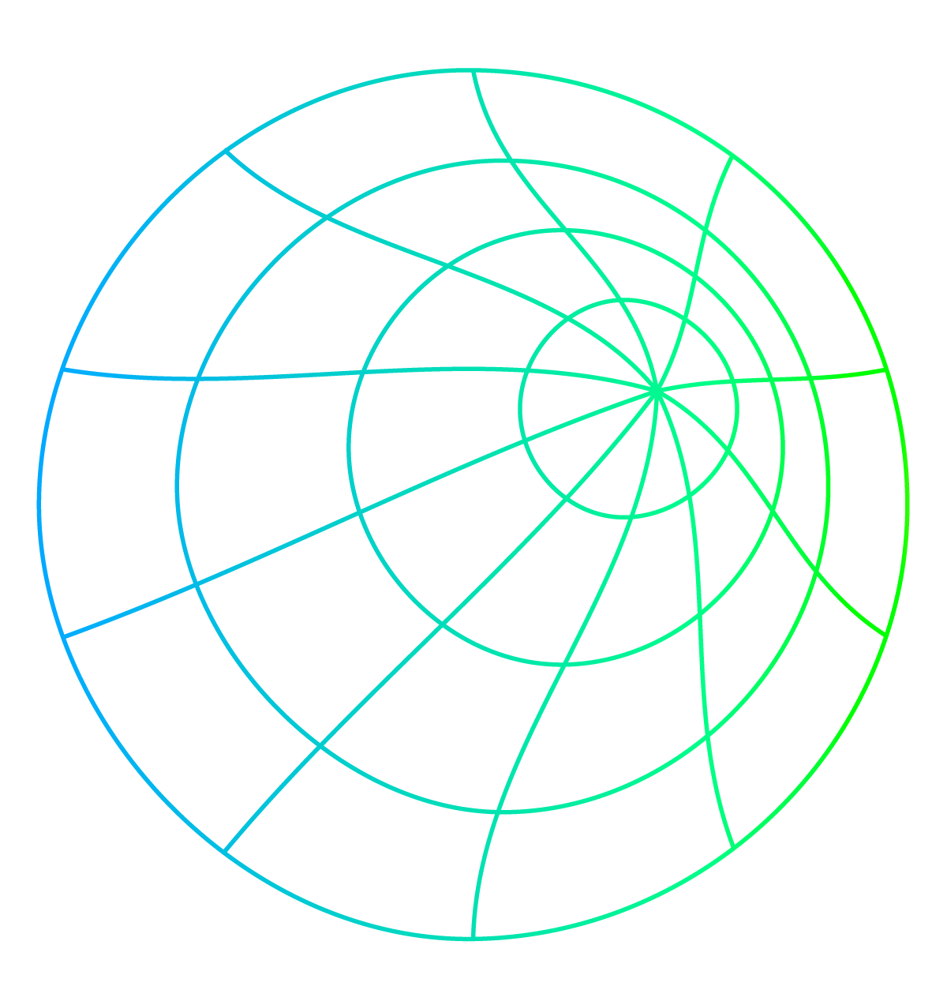
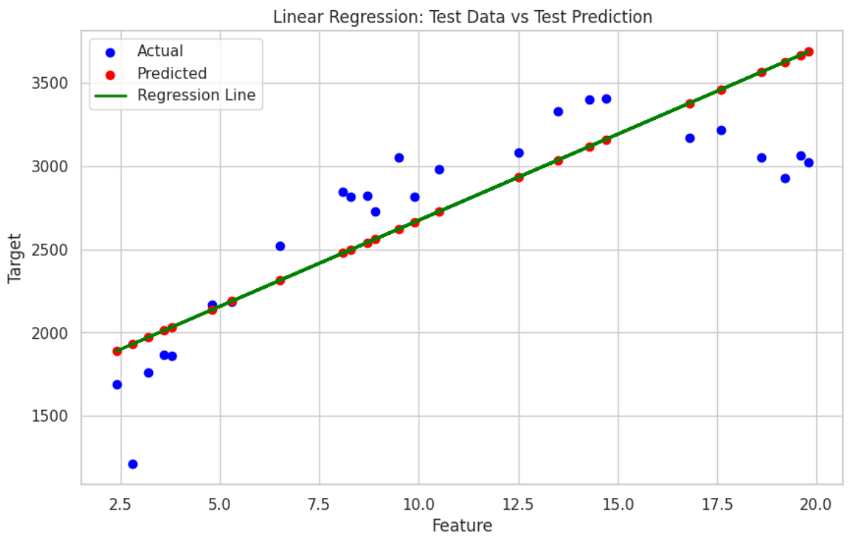
Linear Regression
Mean Squared Error (MSE)
Train : 107699.85
Test : 128111.12
Gap : 20411.27
R^2 Score
Train : 0.77
Test : 0.63

Slide 5
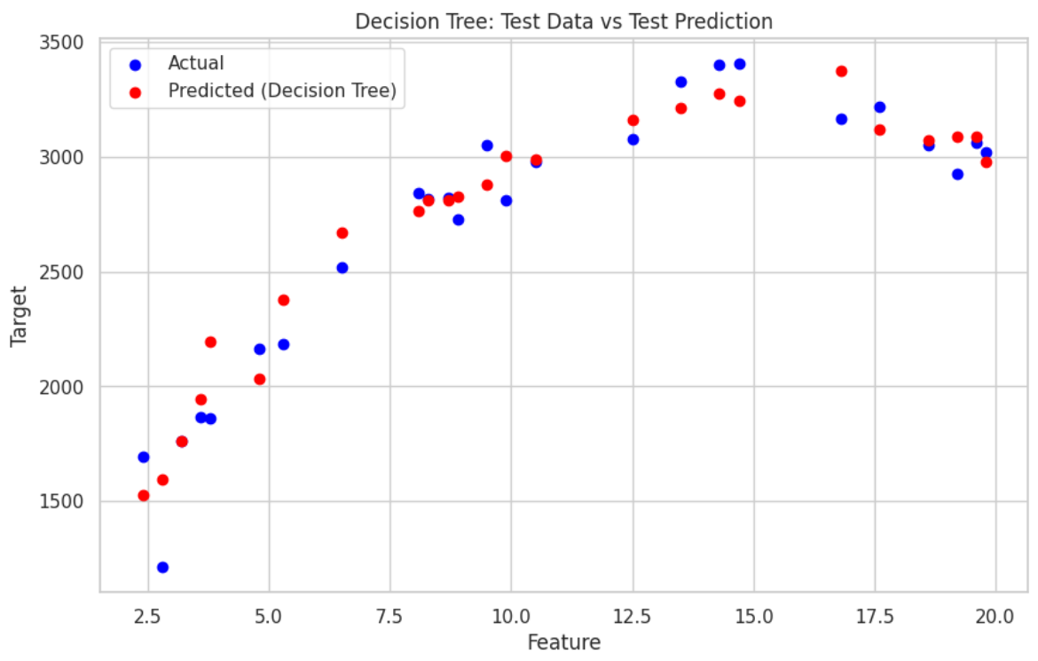
Decision Tree Regressor
Mean Squared Error (MSE)
Train : 88.12
Test : 23627.99
Gap : 23539.87
R^2 Score
Train : 1.00
Test : 0.93

Slide 6
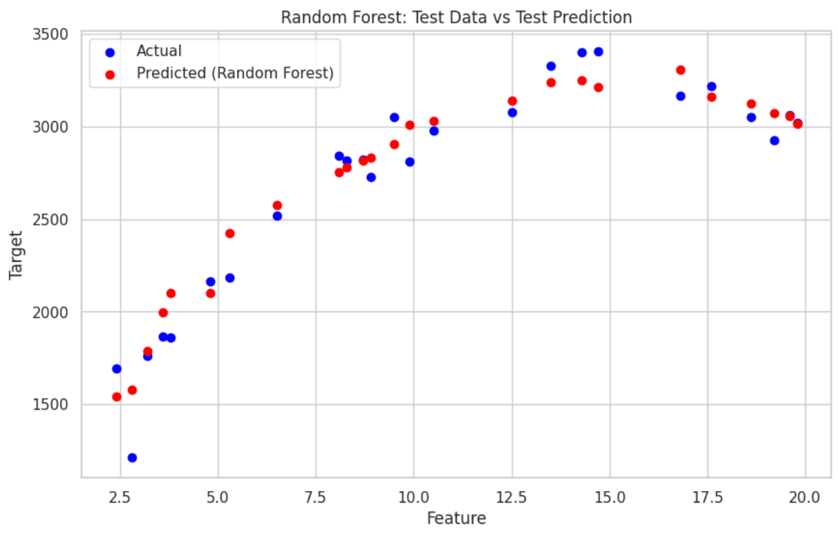
Random Forest Regressor
Mean Squared Error (MSE)
Train : 4600.48
Test : 20113.40
Gap : 15512.92
R^2 Score
Train : 0.99
Test : 0.94

Slide 7
SUMMARY
Model | MSE Train | MSE Test | Gap | R² Train | R² Test
Linear Regression | 107699.85 | 128111.12 | 20411.27 | 0.77 | 0.63
Decision Tree | 88.12 | 23627.99 | 23539.87 | 1.00 | 0.93
Random Forest | 4600.48 | 20113.40 | 15512.92 | 0.99 | 0.94
The Random Forest model demonstrates the best balance between training and testing performance, achieving a high R² score of 0.99 on training data and 0.94 on testing data, along with a relatively small Mean Squared Error gap. The Linear Regression model exhibits significant overfitting, as indicated by its high testing MSE and low R² score, while the Decision Tree model, despite achieving a perfect training R² of 1.00, suffers from extreme overfitting with a substantial gap in MSE. Therefore, the Random Forest model is recommended for deployment, while the Linear Regression and Decision Tree models require further refinement to enhance their generalization capabilities.

Slide 8


Thanks
linkedin.com/in/galihpraditya
github.com/galihpraditya/salary-prediction

